Slide 1
GPU Programming
Lecture-01

Slide 2
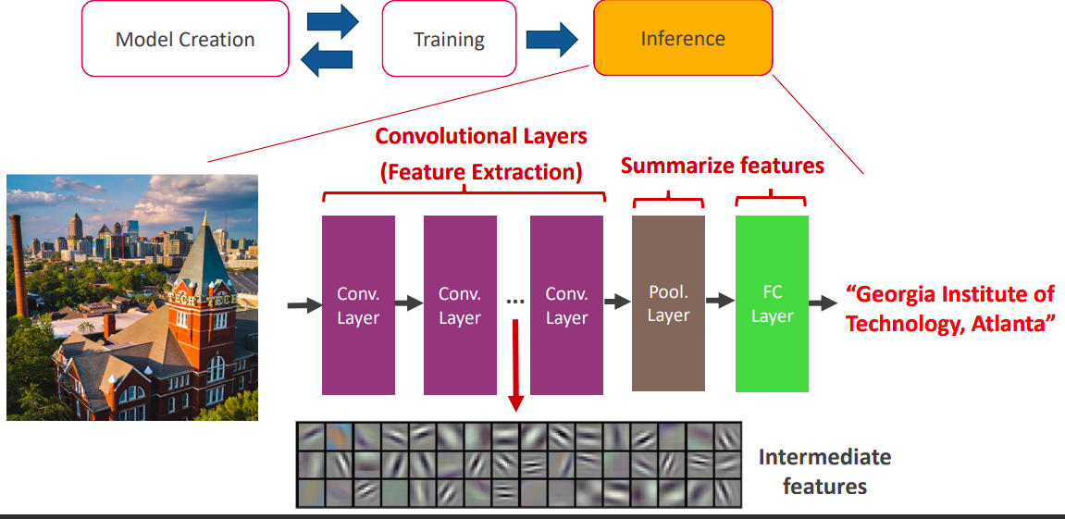

AI Task Example: Image Recognition
IIT JODHPUR
Adapted from Scale-sim Tutorial slides (ASPLOS 2021)

Slide 3
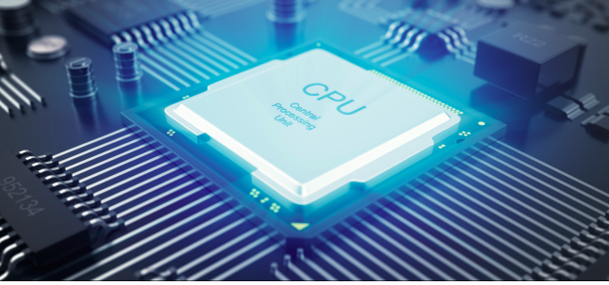
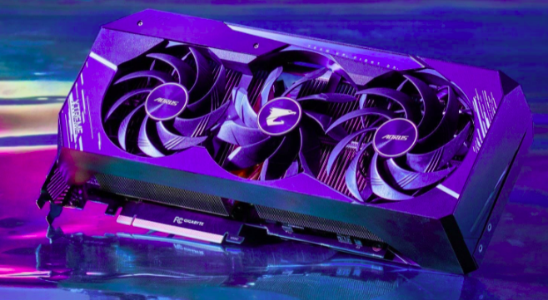
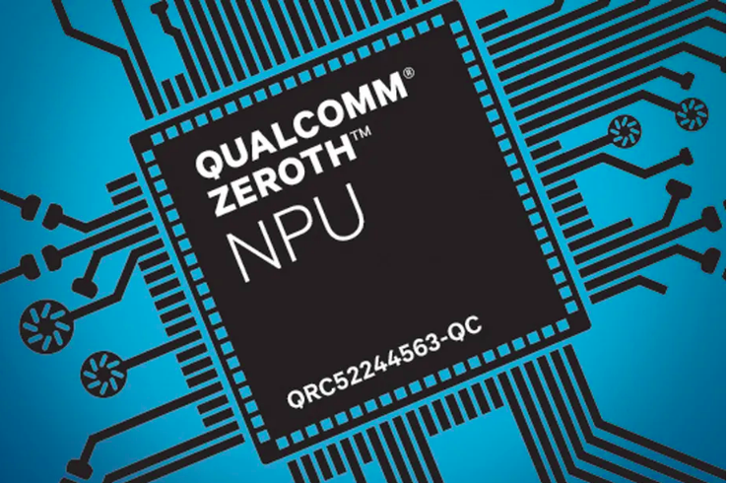
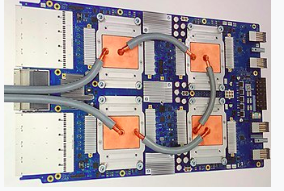
Different Hardware Platforms
CPU (Central Processing Units)
GPU (Graphics Processing Units)
TPU (Tensor Processing Units)
NPU (Neural Processing Units)
FPGAs

Slide 4
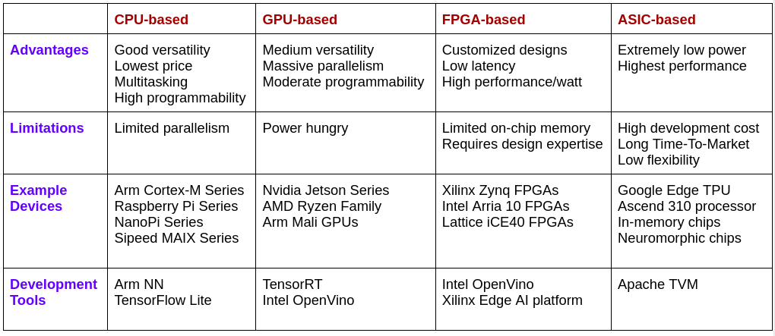
Comparative Evaluation of Different Devices
Adapted from Hao et al., “Enabling Design Methodologies and Future Trends for Edge AI: Specialization and Co-design”, IEEE Design & Test, 2021

Slide 5
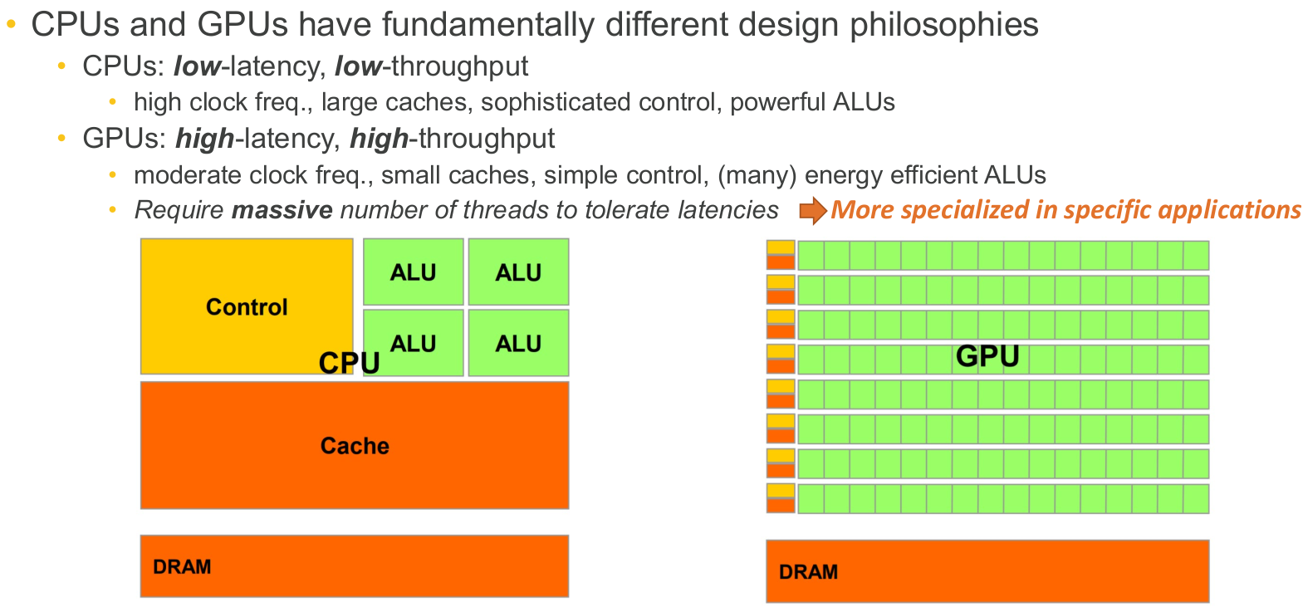
Graphics Processing Unit (GPU)

Slide 6
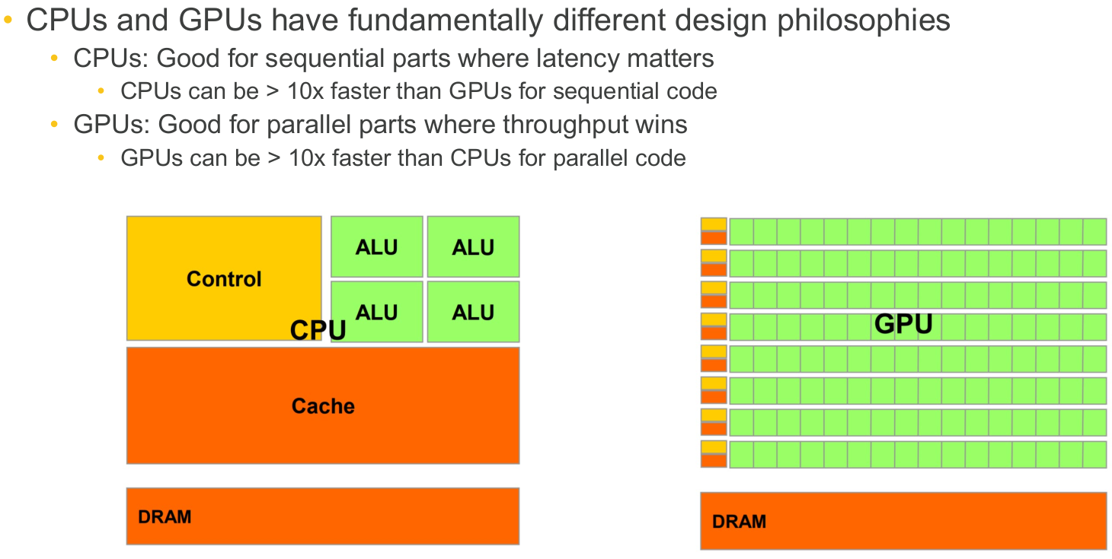
GPU v/s CPU

Slide 7
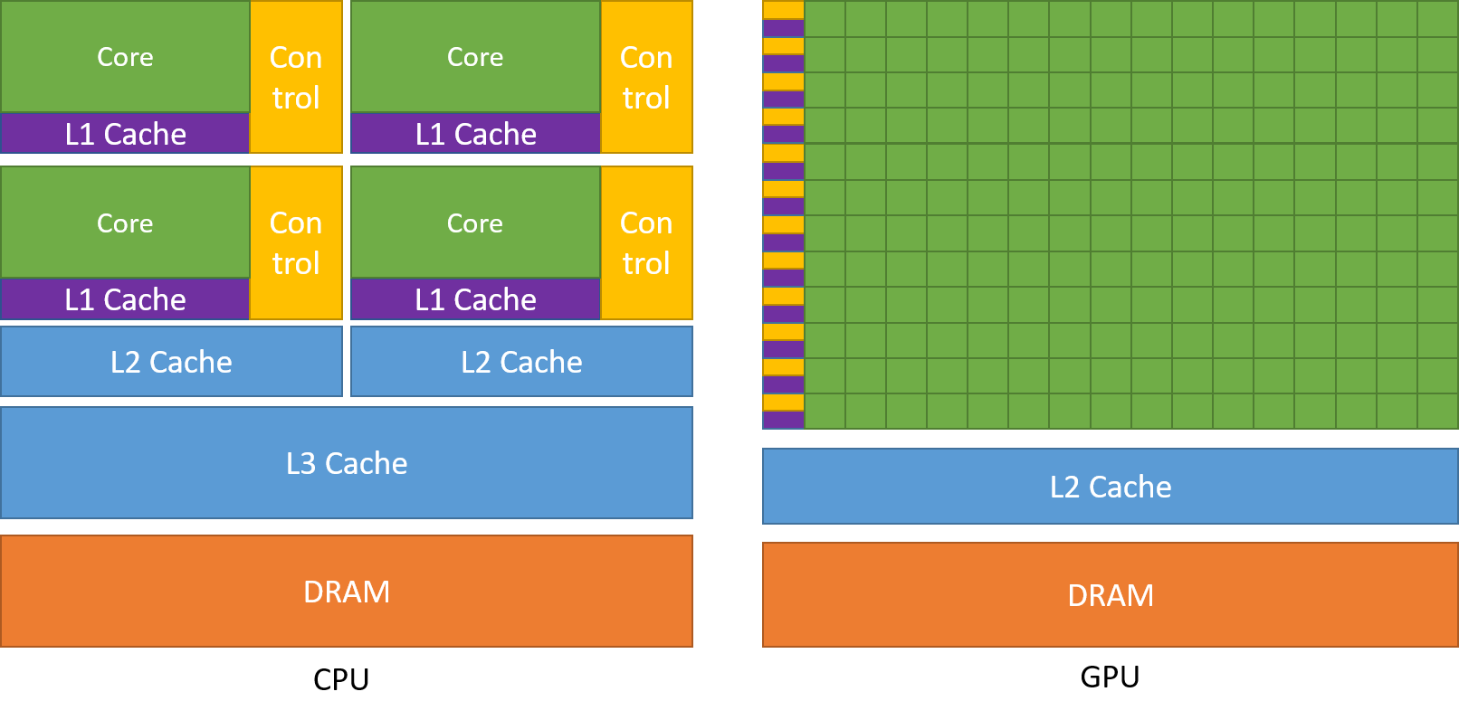
CPU and GPU Compute & Memory Hierarchy

Slide 8
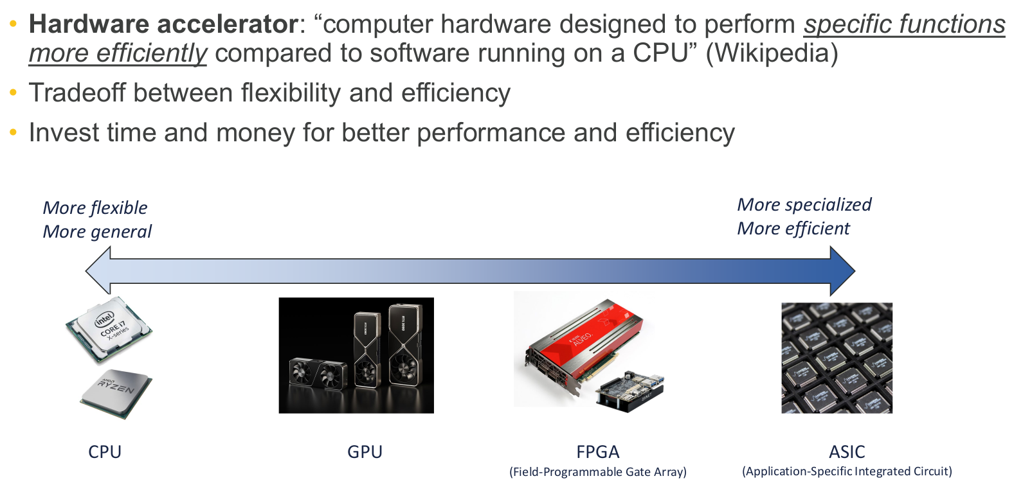
Hardware Accelerator
Accelerator

Slide 9
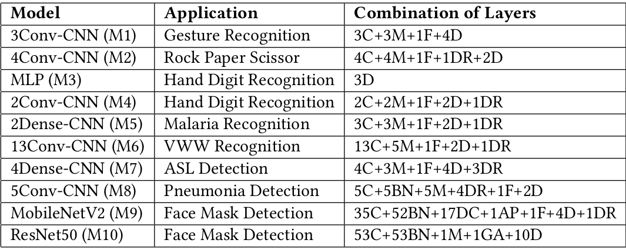
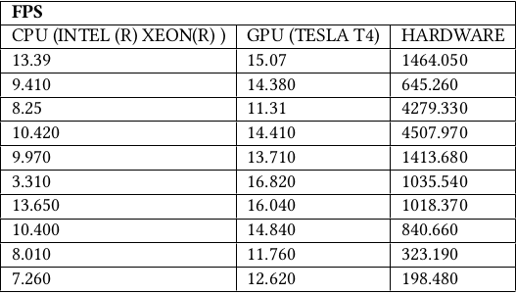
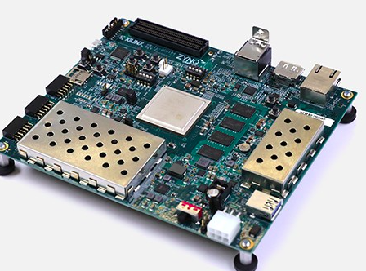
Impact of hardware platforms on execution of AI models?
Let’s take image classification application as case-study
(Frames Per Second)
C = Conv2D, M = MaxPooling2D, F = Flatten, D = Dense, DR = Dropout,
BN = BatchNormalization, DC = DepthwiseConv2d, AP = AveragePooling2D,
GA = GlobalAveragePooling2D
Results obtained on AMD-Xilinx ZCU104 board

Slide 10
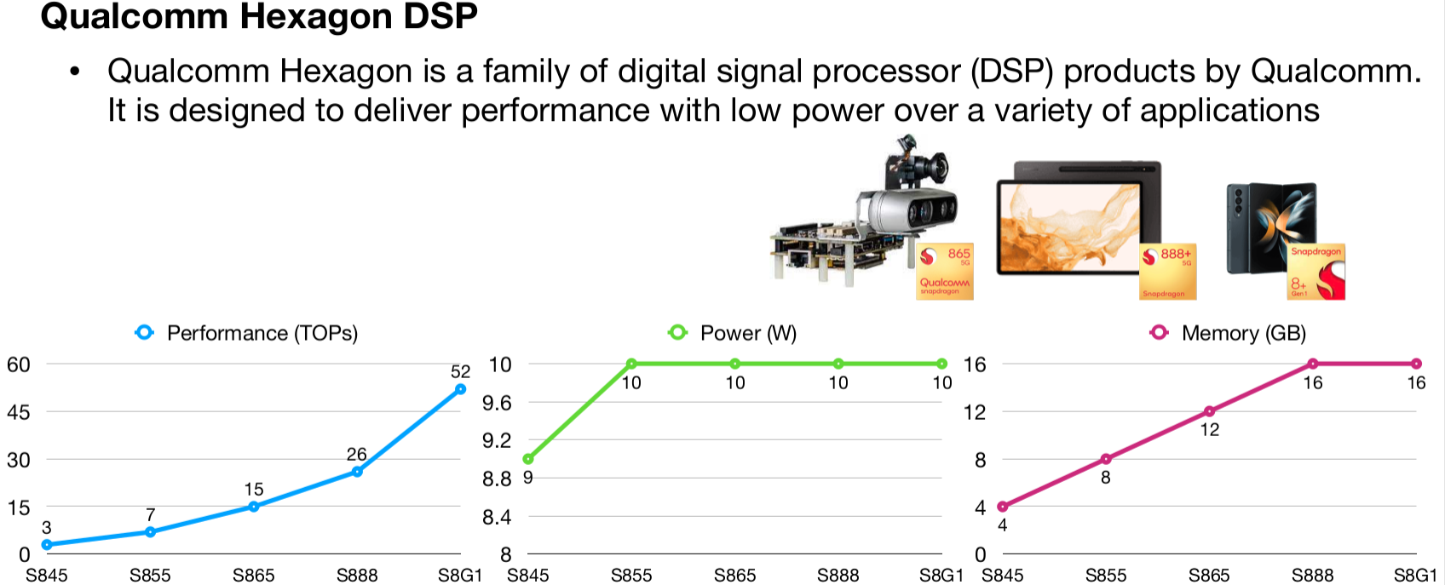
AI Hardware Example 1

Slide 11
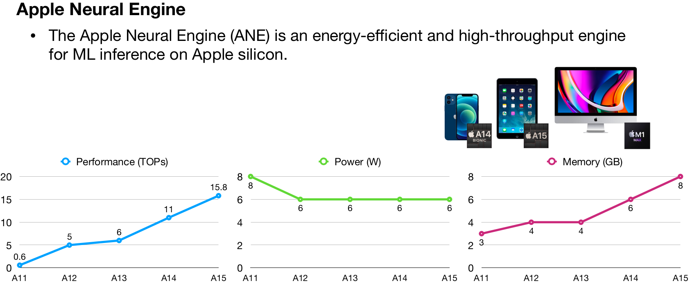
AI Hardware Example 2

Slide 12
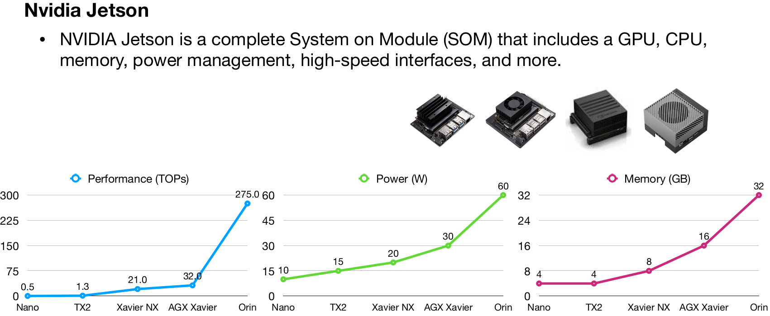
AI Hardware Example 3

Slide 13
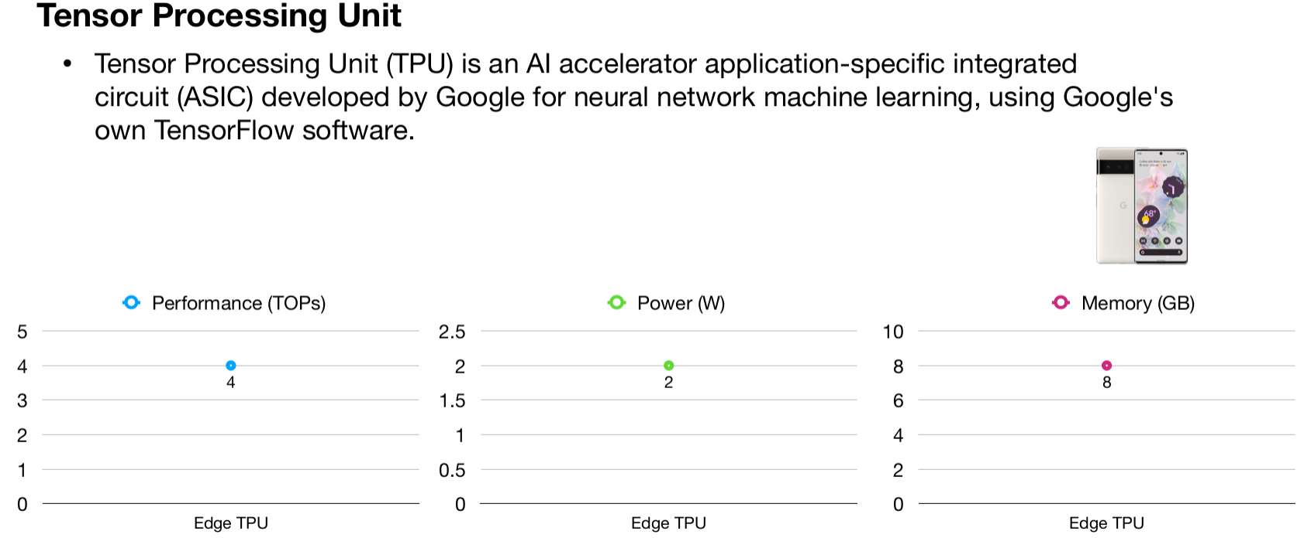
AI Hardware Example 4

Slide 14
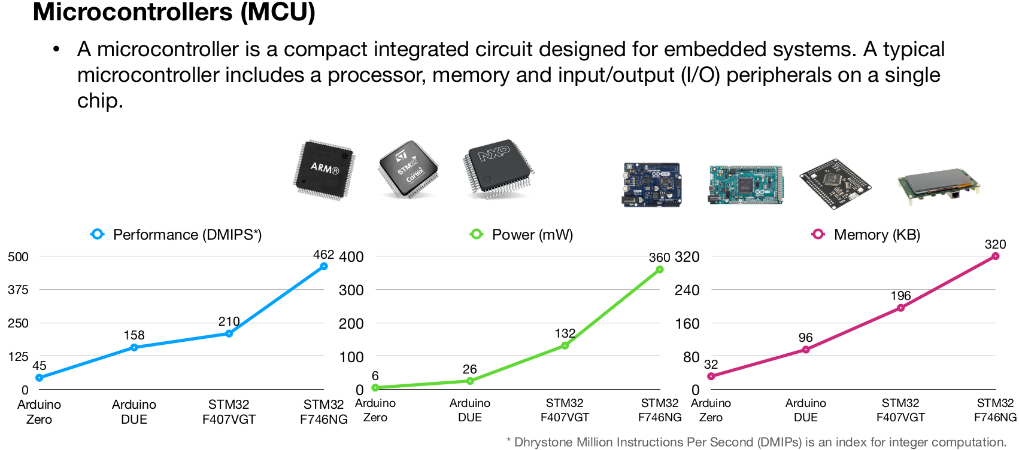
AI Hardware Example 5

Slide 15
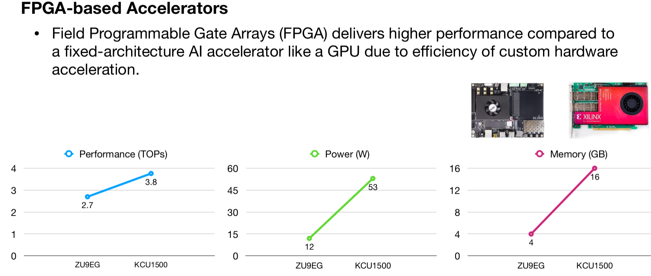
AI Hardware Example 6

Slide 16
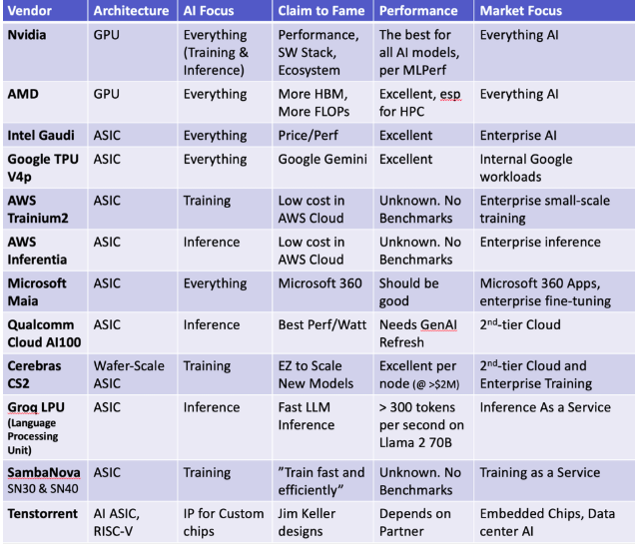
AI Chip Vendors
https://www.forbes.com/sites/karlfreund/2024/02/13/ai-chip-vendors-a-look-at-whos-who-in-the-zoo-in-2024/?sh=3fb71410f6ed

Slide 17
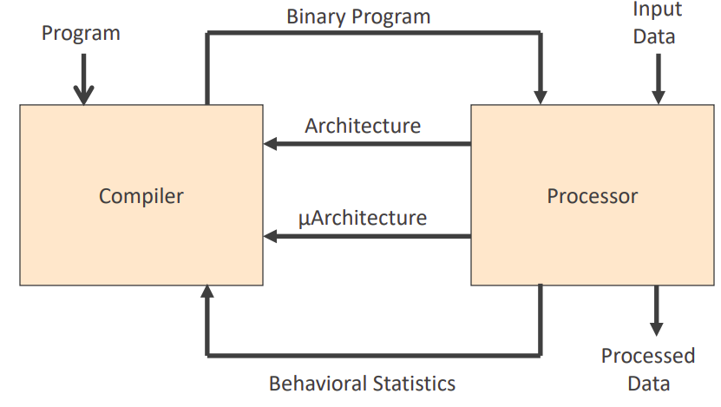
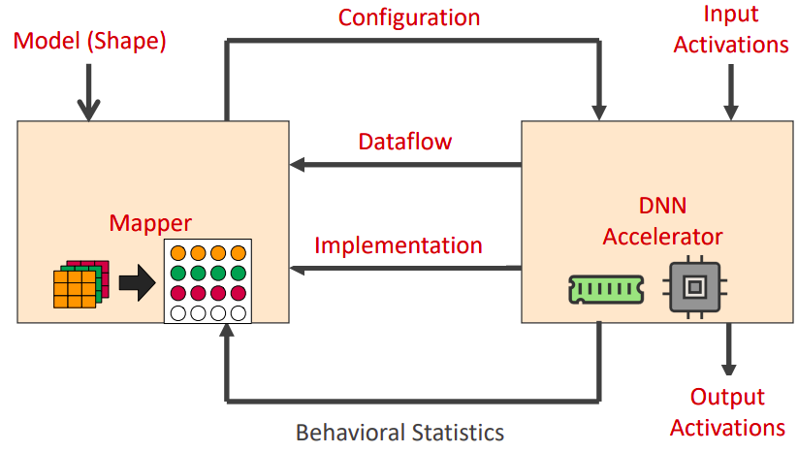
Compute Architectures: CPU v/s Accelerator
Adapted from Eyeriss tutorial slides (ISCA 2019)

Slide 18
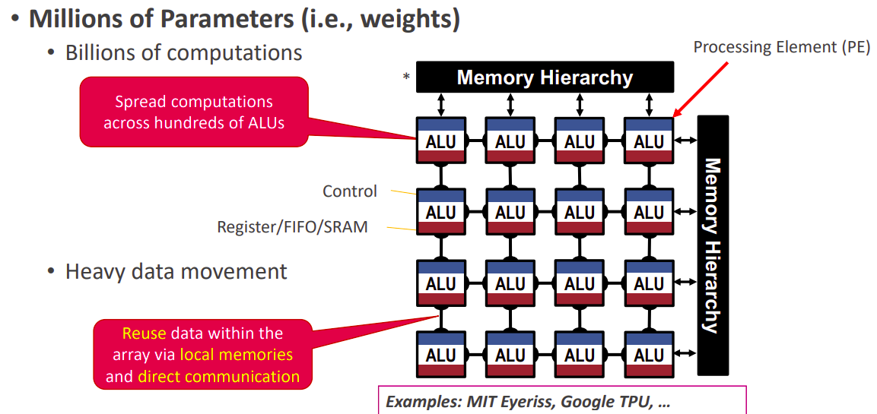
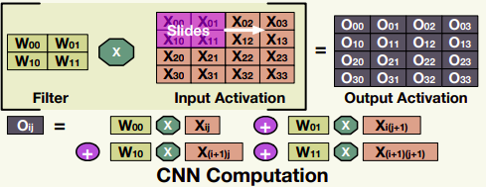
Customised Hardware Architectures (Accelerators)

Slide 19
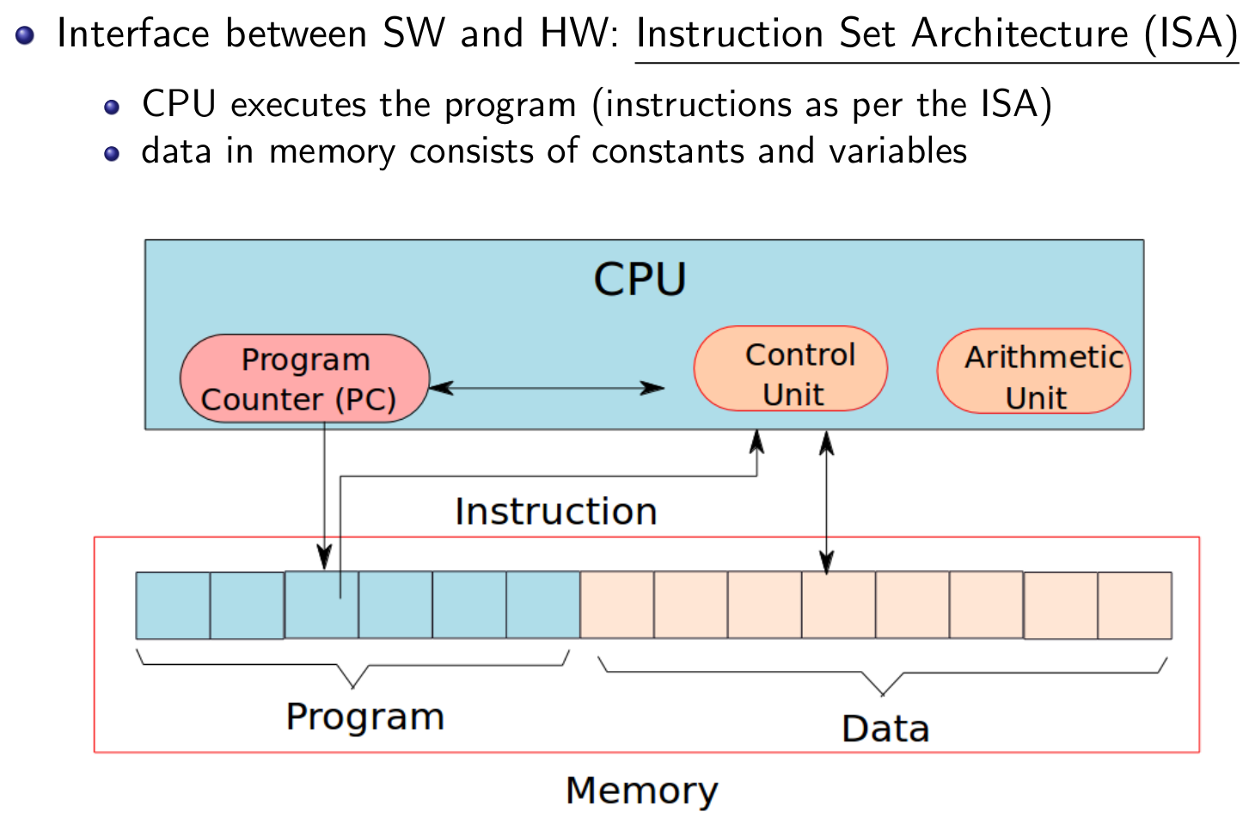
CPU & Instruction Set Architecture (ISA)

Slide 20
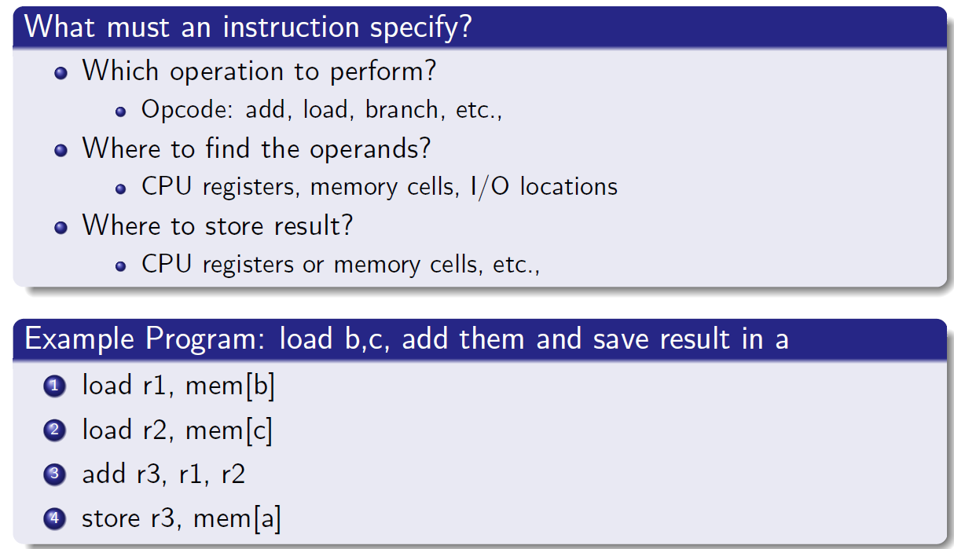
Instruction Set Architecture (ISA)

Slide 21
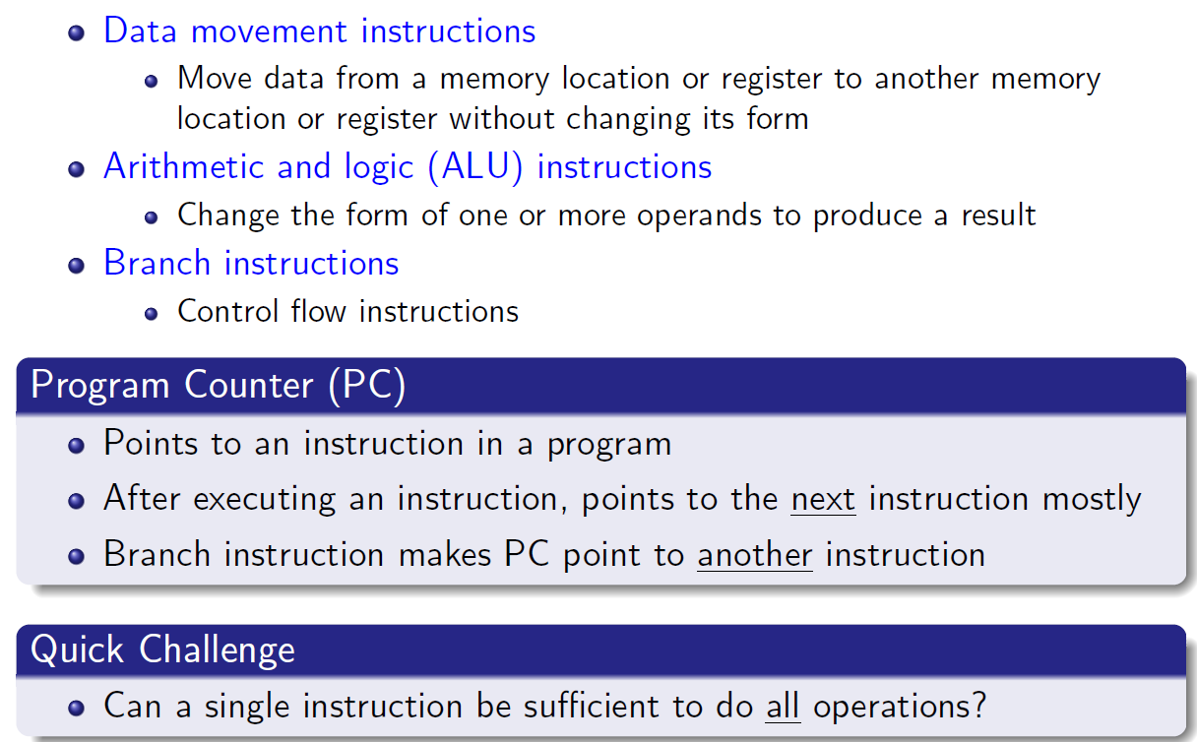
Types of Instructions

Slide 22
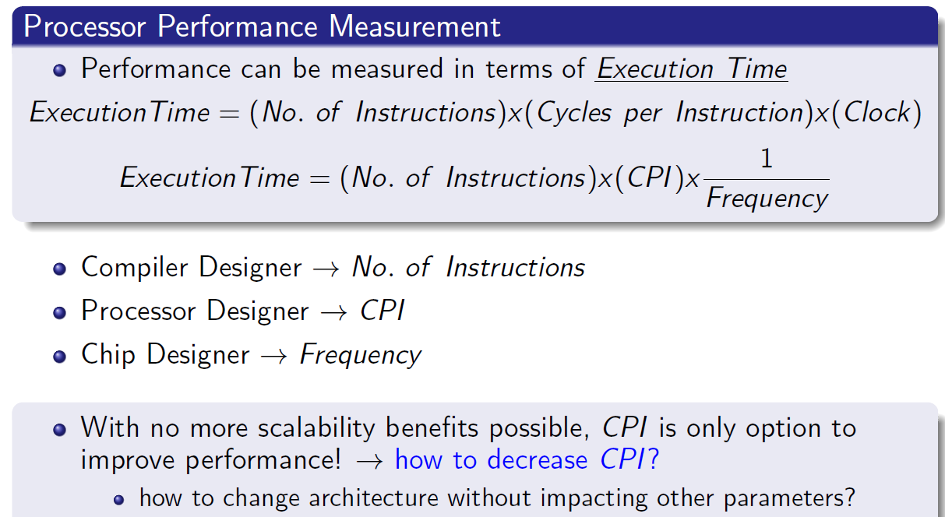
Measuring Performance of a CPU

Slide 23
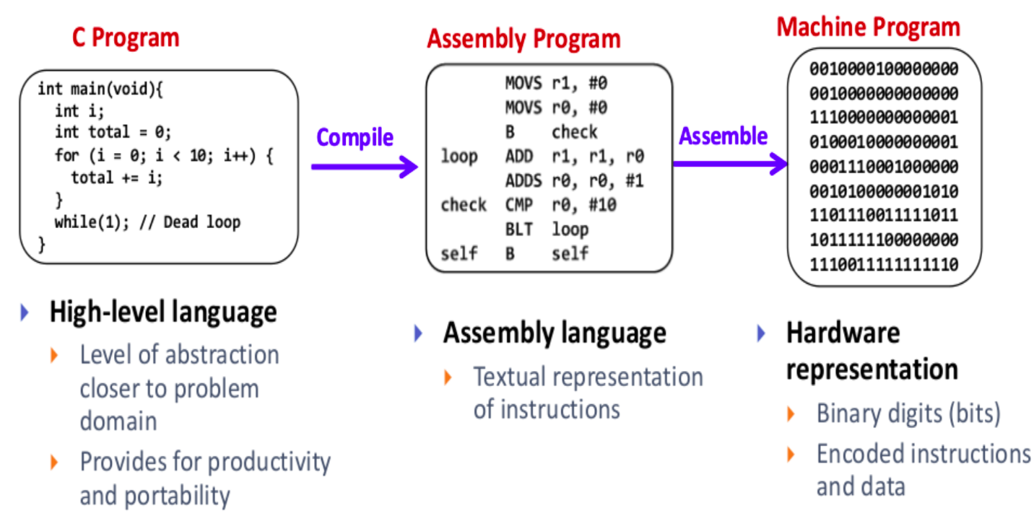
Running a Program (on CPU)

Slide 24
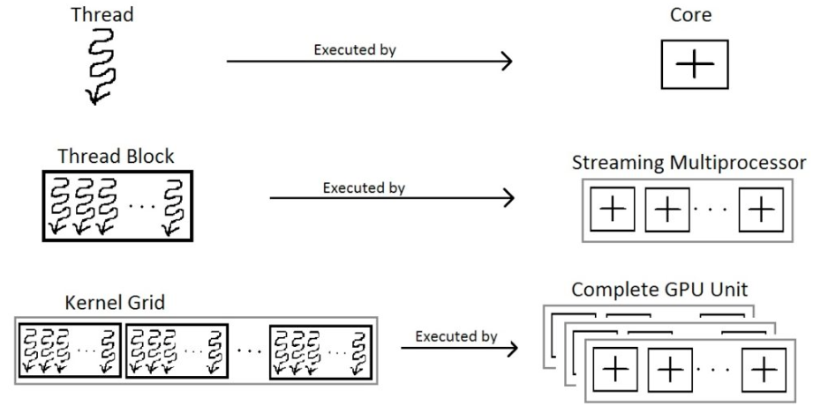
Program Execution illustration (on GPU)

Slide 25
Course Evaluation Scheme
This is the tentative scheme:
Minor | 25
Major | 45
Assignments | 20 | 2 in number (10 + 10)
Quiz | 10 | If valid proof of absence is provided, a replacement assignment can be issued.

